Slide 1
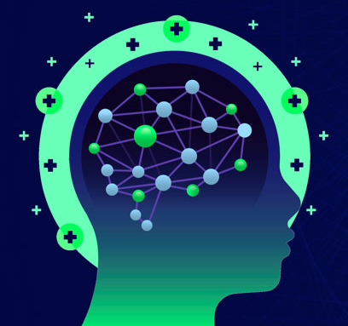
PRE 413: Software Applications for DSP and Communications Assignment 1 of Lecture 1 Lecture Title: Introduction To PRE 413 Course and Deep Learning for DSP and Communications Instructor: Prof. Mohammed Abo-Zahhad Student ID: 012022003 Student Name: Kibitok Abraham Bett Fall 2022

Slide 2
Assignment 1 of Lecture1
Answer the following question by preparing a technical presentation about the deep learning and machine learning topics:
1) Compare between deep learning and machine learning?
2) Advantages and disadvantages of MATLAB and Python in deep learning field?
3) Can MATLAB accept Python Codes and/or Python Code accept MATLAB codes? State some examples (if any)? Search about that in the internet?
4) Is it possible to use Tensor flow and Kerrias environments in MATLAB software?

Slide 3
Question 1
Compare between deep learning and machine learning?
Answer:
Machine learning is a subset of Artificial intelligence that include abstruse statistical techniques to enable machines improve at task with experience.
Deep learning is a subset of machine learning composed of algorithms that permits software to train itself to perform task, by exposing multilayered neural network to vast amount of data.

Slide 4
Question 1 cont..
Machine Learning | Deep Learning
A subset of Artificial intelligence | A subset of machine learning
Requires less computing power with greater human intervention. | Requires high computing power with less human intervention.
More suitable for organized and small data like spread sheets. | Can process complex and unstructured data like videos and images.
Can have a single hidden neuron layer. | Have more than one hidden layer of neurons

Slide 5
Question 2
Advantages and disadvantages of MATLAB and Python in deep learning field?
Advantages of MATLAB
Good at designing and fine-tuning algorithms. It offers a bunch of toolboxes that can help you process different applications. Examples of toolbox include deep learning, signal processing, robotics and autonomous vehicles.
Easy and simple when doing operations that involve matrix operations.
MATLAB is faster than python while doing some tasks since python is an interpreter language.
Invaluable for signal processing compared to python due to the advanced libraries and packages developed in its toolbox.
MathWorks provides an organized community and documentation for assistance.
Has a better Plotting and Visualization which is simple to use compared to Python

Slide 6
Question 2 cont..
Advantages and disadvantages of MATLAB and Python in deep learning field?
Disadvantages of MATLAB
Difficult to use for dataset that has cannot be represented as a numeric feature matrix.
Lacks a good open-source community setup compared to python.
MATLAB does not create application deployment tasks like set up files and executables file hence not suitable in making the products.
Challenging when doing cross compiling or converting its codes to other programming languages.

Slide 7
Question 2 cont..
Advantages and disadvantages of MATLAB and Python in deep learning field?
Advantages of Python
Provides a good open-source ecosystem hence highly scalable in terms of libraries and solutions.
Provides a better handling for problems that don’t come as a simple feature matrix, by using tools like pandas and ntlk libraries, these task can be easily solved.
It can create application deployment tasks like set up files and executables file hence suitable in making the products.
Ipython Notebooks provides a nice interactive data analysis platform for deep learning algorithms.
Has a comprehensive and fragmented scientific computing stack Pandas, scikit, NumPy, SciPy, python, & matplotlib that are mostly used scientific computing libraries

Slide 8
Question 2 cont..
Advantages and disadvantages of MATLAB and Python in deep learning field?
Disadvantages of Python
When using it, there is a need to install a lot of third-party packages.
Some computing stacks are still stuck in python 2.7 making the upgrading task unfeasible.
Slow when used without going into cpython as it is an interpreter language.

Slide 9
Question 3
Can MATLAB accept Python Codes and/or Python Code accept MATLAB codes? State some examples (if any)? Search about that in the internet?
MATLAB provides a means interfacing with other programming languages through MATLAB External Language Interfaces. Python libraries and method can be directly accessed from MATLAB by adding py. prefix to the Python name. Examples are Use Python Numeric Variables in MATLAB and Use Python Tuple Variables in MATLAB.
MATLAB engine api allows you to call MATLAB as a computational engine from other languages including python. It allows execution of MATLAB commands within Python environment without starting MATLAB. Example Call MATLAB in python and Run matlab function from python script.

Slide 10
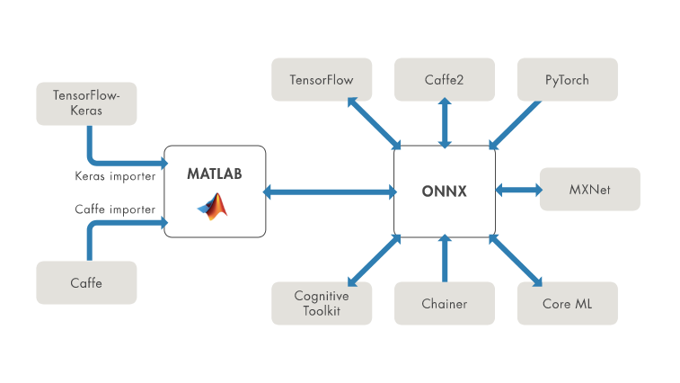
Question 4
Is it possible to use Tensor flow and Keras environments in MATLAB software?
Deep learning toolbox convertor for TensorFlows Models allows importation of pretrained TensorFlow Model and weights as well as export of a MATLAB Network or layergraph as TensorFlow model.
importKerasNetwork function allows the importation of a pretrained TensorFlow™-Keras network and its weights from a file .
Fig 1. ONNX format model
Deep Learning Toolbox Converter for PyTorch Models enables the importation of pretrained PyTorch models and weights to MATLAB.
MATLAB supports importing and exporting open-source deep learning frameworks with the Open Neural Network Exchange (ONNX) format.

